Slide 1
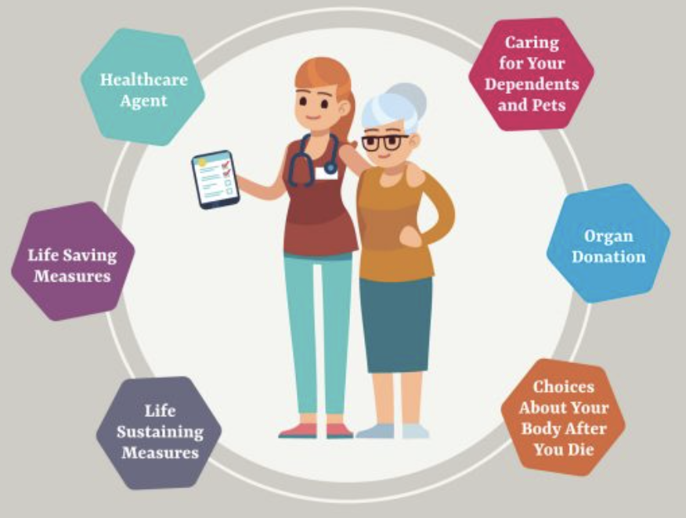
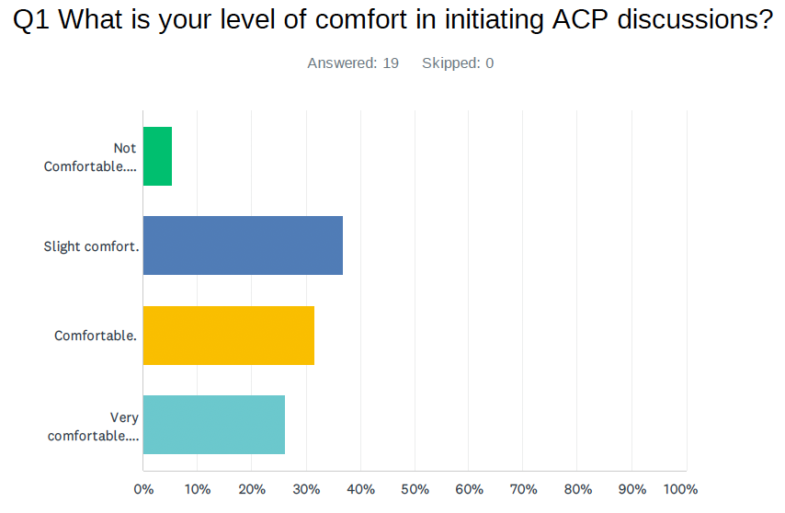
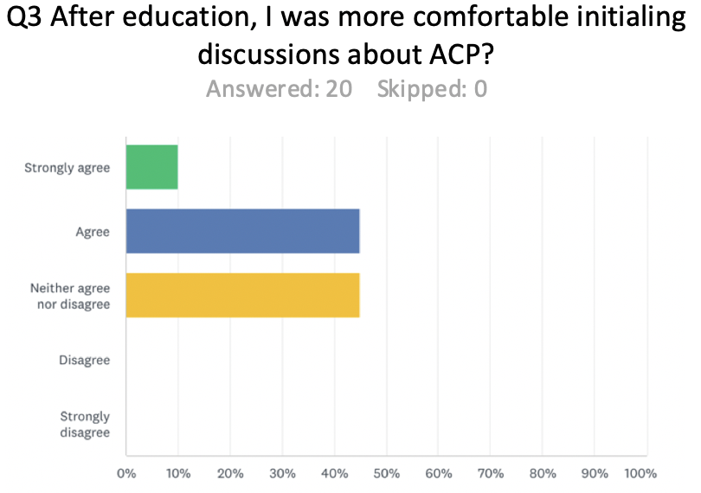
The Role of Educational Intervention and Implementation of a Standardized ACP EMR Template in Improving ACP Discussion and Documentation with Geriatric Patients at Regina Centre Crossing Family Medicine Unit
Gill, G., Saini S, Pietrzyk, J., Beaurivage, B. Clay, A., Marwah, R.
Introduction
Methods
Discussion
Advance care planning (ACP) is defined as “the process of discussing and recording preferences concerning goals of care for patients who may lose capacity or communication ability in the future” (1).
There’s an increasing global trend of older populations. Estimated between years 2015 and 2050, the global population of those aged 60 and older will nearly double (2). As a result, there will be more patients with chronic and life-limiting illnesses thus emphasizing the importance of identifying the need for and initiation of ACP.
The ACP discussion involves: discussion of disease and prognosis, treatment options, and documentation of patients’ values that shape their unique ACP (2)(3). Unfortunately, appropriate initiation of ACP requires an understanding of factors that facilitate and hinder the implementation of ACP. As such, a patient's’ lack of understanding of what constitutes ACP leads to lower rates of perceived initiation of ACP compared to health care professionals’ (HCP) perceived initiation rates (4).
Another barrier to improving rates of ACP, is that of appropriate documentation. According to Ben Ami et al. (2), 50-60% of older adults claim completion of an ACP document, however, the documents were found only in the EHR 4-13% of the time. Currently it has been identified that in the setting of ACP, patients will prefer HCP to initiate conversation (4). Unfortunately, barriers to the initiation of ACP amongst HCP include lack of physician training for appropriate identification and timing of ACP in the setting of unpredictable disease processes and time constraints (4). Furthermore, there exists a lack of standardized documentation for ACP thus impacting rates of ACP (3). Finally, a key barrier in ACP initiation is that of misconceptions that autonomy is lost by patients and family members through this process thus increasing avoidance in engagement of ACP.
A review by Poveda-Moral et al, found that major HCP barriers were lack of education in implementing ACP, discomfort in having these discussions and lack of time. Patient-related barriers included discomfort in discussing the end-of-life of loved ones, lack of awareness of how to complete ACP and who would begin the process (5). Currently, it is unclear how to appropriately use all elements of ACP for effective documentation of directives with the goal of improving quality of end of life care (6).
Existing barriers are preventing the initiation and standardized documentation of advanced care planning for the geriatric population at the Family Medicine Unit at Regina Centre Crossing. Barriers are both patient and physician dependent.
ACP planning is a high value intervention that can be initiated by physicians to improve quality of life for older patients and those with life-limiting illness. By implementing an EMR supported ACP documentation together with physician and staff education and training on ACP communication, Rose et al. (8) measured that 7200 ACP conversations in 36 primary care settings were initiated. Previously, these 7200 had no advanced directives scanned into the EMR but with these new interventions, 29% now had advanced directives in the EMR analyzed in a 10- month period (8). A systematic review completed by Huber et al. (9) showed that EHR interventions in the setting of ACP communication were efficacious with an improvement in 1 or more advanced care planning outcomes. (9)
An ongoing quality improvement project at the Family Medicine Unit (FMU) in Regina, Saskatchewan, aims at increasing discussion and documentation of Advanced Care Planning (ACP) for patients 65 and older. This has been studied by rolling out Plan Develop Study and Act (PDSA) cycles every three months, iteratively. To date, we have rolled out three cycles. The method followed is:
This ongoing project has analyzed the barriers to provider ACP communication and documentation as well as the changes in ACP documentation recorded in the EMR pre and post educational interventions.
124 patients with ACP documents in the care plan or preferences section of the EMR were analyzed from a sample size of 1234 active patients meeting the inclusion criteria. The lower percentage of charts with ACP documents in the EMR in comparison to the number of active patients could be in part be due to incomplete transfer of ACP documents from paper charts before EMR initiation.
Additionally, there were 41 documents labelled as “My Voice” in the EMR that may have overlapped with the care plan or preference section and therefore were not included when calculating the increase in ACP documents after both interventions.
Assessment of the first PDSA cycle revealed an improvement in provider confidence and ACP documentation at FMU following education on ACP. However, the generalizability of this approach may be limited by non-academic physician’s time and access to educational interventions such as the medical lecture and insufficient time for self-review.
Analytics show an increase in ACP documents in the EMR by 10.5% after the first PDSA cycle and 8.8% after the second PDSA cycle. The increase by 20.2% over both PDSA cycles is a result of the formal training undergone by providers. This intervention did not address time constraints which was the principle barrier identified with the initial survey.
Additional factors that may have influenced ACP documentation in the EMR are patients who decline ACP conversations, and incomplete follow-up with patients to ensure ACP documentation is retrieved and recorded.
Reports were generated from the EMR to extract the process outcomes. This numerical data was found to be dynamic when analyzed with the same parameters at different time intervals. This could be in part due to patients aging and meeting the inclusion criteria of 65 years of age, or being removed from the EMR due to their demise.
The barriers identified are consistent with the literature, which include provider time constraints, lack of formal ACP education, and the absence of a standardized ACP template in the EMR.
Step 1
Step 2
Step 3
Step 4
Step 5
Administered an initial survey to assess provider (faculty and residents) confidence and barriers to initiating ACP discussions with patients.
Delivered education to providers through self-directed review of SHA guidelines on ACP and an educational session by Medical Director for the SHA ACP Program.
Administered a second survey utilizing the survey monkey platform to providers to study the impact of the educational interventions: self-directed review of SHA ACP guidelines, and ACP education lecture
Assessed the process outcomes by analysing the number of charts in the EMR with ACP documentation
Developed a standardized ACP EMR template to guide providers with ACP discussions and documentation. The impact of this will be assessed at the end of current (third) PDSA cycle
(7)
Results
The first survey delivered in March to Providers (n = 19) indicated that 36.84% were slightly comfortable, 31.50% were comfortable and 26.2% were very comfortable in initiating ACP discussions. Additionally, 5.26% expressed they were not comfortable in initiating ACP discussions (Table 1a). The initial survey indicated that time (89.47%), lack of formal training (57.89%) and the absence of a formal standardized ACP template (31.58%) were barriers to initiating/documenting ACP discussions. Table 2 reflects the increase in ACP documentation from baseline across 3 modalities to be a total of 16 during the first PDSA cycle.
The second PDSA cycle taking place between April 1 – June 30, 2023, introduced learning material (pre-readings) and Dr. K. Mohr’s lecture to address the lack of formal training. The second survey (n = 20) showed that following the intervention, 10% strongly agreed and 45% of FMU staff agreed they were more comfortable in initiating ACP discussions (Table 1b). Whereas 45% of FMU staff neither agreed nor disagreed that the interventions improved their level of comfort (Table 1). Following the interventions, there were 16 new ACP discussions documented in the EMR during the second PDSA cycle.
Post educational intervention, the survey emailed to all provider clinicians including residents revealed an increase of about 10.5% ( additional 13 documents). After Dr. Mohr’s discussion, the numbers the EMR increased by about 8.8 % (increase of 12 documents).
Table 1a
Conclusions & Future Research
Objectives
Thus far, our study has shown an improvement in numbers which may be due to increased confidence in providers due to interventions implemented so far, including but not limited to educational intervention.
1. The next PDSA cycle will assess the impact of implementing a standardized ACP template, ACP-related posters and EMR-based reminders on rates of ACP documentation. The objective is to analyse the survey-cited barriers of time and topic sensitivity to improve process outcomes.
2. Patient barriers were not addressed within this study methodology and can be a focus for future PDSA cycles with the objective of improving patient experience.
1.
Identification of provider barriers to ACP documentation.
2.
Assess the impact of educational interventions on ACP documentation in the EMR
Table 1b
3.
Development and Implementation of a standardized template
References
4.
Analyze the impact of provider utilization of a standardized ACP document in the EMR on ACP documentation
Table 2
(1) Brinkman-Stoppelenburg A, Rietjens JA, van der Heide A. The effects of advance care planning on end-of-life care: a systematic review. Palliat Med. 2014;28(8):1000–25.
(2) Ben Ami N, Shvartzman P. Oncologists’ Approaches and Barriers for Discussing Advanced Care Planning with Severely Ill Cancer Patients. Harefuah. 2022 May; 161(5):316-321
(3) Myers J, Cosby R, Gzik D, et al. Provider Tools for Advance Care Planning and Goals of Care Discussions: A Systematic Review. American Journal of Hospice and Palliative Medicine®. 2018;35(8):1123-1132.
(4) Hall A., Rowland c., Grande G. Hope Should End-of-Life Advance Care Planning Discussions Be Implemented According to Patients and Informal Carers? A Qualitative Review of Reviews. J Pain Sym Man. 2019 April; 58(2): 311-335.
(5) Poveda-Moral S., Falcó-Pegueroles A., Ballesteros-Silva M.P., Bosch-Alcaraz A. Barriers to Advance Care Planning Implementation in Health Care: An Umbrella Review with Implications of Evidence-Based Practice. Worldviews Evid Based Nurs. 2021 Sept; 18(5): 254-263.
(7) Walker, P. (2021). Normalizing ACP gives patients power and families peace of mind. URL: https://www.epicshare.org/share-and-learn/normalizing-advance-care-planning-gives-patients-power-and-families-peace-of-mind
(6) Massheder-Dollman I., Wright J., Scullion E., Hockley D., Beaumont C., et al. The Challenges of a Modern Nurse-Led Palliative and End of Life Care Unit. BMJ Support & Palliat Care. 2017; 7(Suppl 2): A1-A120
(8) Rose BL, Leung S, Gustin J, Childers J. Initiating advance care planning in primary care: a model for success. J Palliat Med. 2019 Apr;22(4):427-431. doi: 10.1089/jpm.2018.0380
(9) Huber MT, Highland JD, Krishnamoorthi VR, Tang JW. Utilizing the Electronic Health Record to Improve Advance Care Planning: A Systematic Review. Am J Hosp Palliat Care. 2018 Mar;35(3):532-541. doi: 10.1177/1049909117715217. Epub 2017 Jun 19. PMID: 28627287.
 | Baseline | PDSA Cycle 1 | PDSA Cycle 2
 | Beginning of EMR-Dec 31, 2022 | Jan 1 2023-March 31 2023 | April 1 2023-June 30 2023
Careplan Item Advanced Care Directives | 67 | 12 | 10
Preferences Item Advanced Care Directive | 57 | 1 | 2
Any profile Item with Description of My Voice | 41 | 3 | 4
5.
To increase the initial 6% of patients who have ACP documentation in the EMR to 20%.

