Slide 1
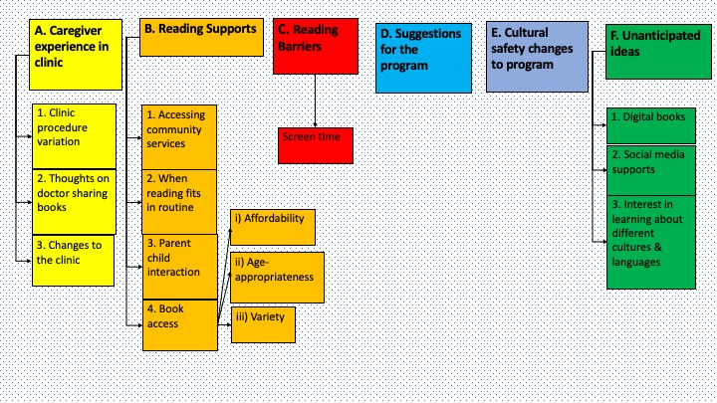
Supporting Early Literacy in a Primary Care Setting – Caregiver Experiences
Oluwabukunmi Adesina BSP; Meredith McKague MD CCFP; Jennifer Knibbs MD, BSN, FMR1; Ginger Ruddy MD CCFP, MPH
INTRODUCTION
METHODS
DISCUSSIONS and CONCLUSIONS
Sharing books with children fosters important neural networks which are especially crucial to acquire in early childhood.¹ Unfortunately, socioeconomic status affects children’s word exposure with higher socioeconomic status associated with greater word exposure by age 3.² Also, at ages 4 and 5, children born into low-income households knew fewer letters than their middle-class colleagues.² Sadly, poor literacy can impact health, access to, and use of healthcare services.^{3,4}
To combat this problem, a program was launched in January 2020 at West Winds Primary Health Centre in Saskatoon Saskatchewan, to promote early literacy in children aged 6 months to 5 years. The program was modelled after the successful Reach Out and Read program from the United States.^{5,6}
The key aspects of this program include:
Physician promotes literacy during well-child visits
Physician presents an age-appropriate book to the child and models book-sharing with the child
The following was included with the book presented:
A bookmark from READ Saskatoon promoting their services
A “prescription to read” document from Saskatoon Public library that can also be used to apply for a library card
A handout from Saskatchewan Literacy Network explaining how to share books with children based on their developmental stage
The waiting room is more literacy-rich by adding posters and books donated by the Saskatoon Public library
Saskatoon Public Library librarians reads to children in the waiting rooms on Friday afternoons
This program ran for about 6 weeks before it was interrupted by the Coronavirus Disease 2019 (COVID-19) pandemic in March 2020. The program has resumed again as in-person well-child visits have restarted.
All caregivers who participated in the program were invited to small groups to discuss their experiences. Two small group discussions were conducted via Cisco WebEx in July 2020 with one participant attending each session. Both participants were mothers and had children between ages 1 and 4 years. They each attended one well-child visit after program initiation. The transcript was analyzed and coded by the researchers with the key themes identified. This project was approved by the Behavioral Ethics Board at the University of Saskatchewan.
Education is a social determinant of health. Primary care providers promoting early literacy can significantly improve future patients’ health and wellbeing. Programs like this help prepare children to be successful in schools and later in life. The program is off to a great start with positive feedback from parents. This project emphasizes the value of early literacy promotion in a primary care setting. There is a need to improve the literacy-promoting signage in the waiting room, particularly the availability of free books provided by the public library. There is also a need to reiterate to physicians the importance of this initiative to ensure standardization of experiences and consistency of literacy promotion. READ Saskatoon and the Saskatoon Public Library are already doing important work to promote literacy and working with them helps increase the impact of this program.
Limitations included a small sample size. Also, there was a change in the format of the project from the intended small groups to interviews when some participants did not show up. In addition, none of the participants were visible or self-identified minorities, so there was limited feedback on the cultural safety of the program. Finally, those who participated were socioeconomically privileged and were knowledgeable in identifying and utilizing community resources so their experiences might not accurately reflect the majority of those involved in this program.
Recommendations: Additional small group discussions should be conducted to assess the program and should include families from different socioeconomic and cultural backgrounds. Further sampling should continue until saturation of ideas is reached.
RESULTS
Figure 1: Key themes
The six main categories identified from the transcript are:
Caregiver experiences in clinic: General feedback about the project was positive but there were variations in experiences with one participant receiving the book after the visit and not from her doctor. No participant noticed the changes in the waiting area, but one noticed the changes in the clinic rooms.
Resources and experiences supporting book-sharing: Saskatoon Public Library, READ Saskatoon, Mommy Connections Saskatoon were accessed in the community. Sharing books was a positive experience for parents. Having affordable, age-appropriate, and a variety of books was important.
Barriers to sharing books with children: Time was the biggest barrier. Screen time was not a major barrier for either family.
General suggestions for the program: Suggestions include ensuring the primary care provider reiterates the importance of sharing books with kids. Adding a free “book-exchange library” at the clinic was also proposed to improve access.
Cultural safety changes to the program: Limited feedback on this, but culturally safe from the participants’ perspective.
Unanticipated ideas: There was an interest in receiving books from different cultures. Free digital books were utilized by families to increase accessibility. Social media “mommy blogs” also influenced parenting behaviors.
REFERENCES
Atkinson PM, Parks DK, Cooley SM, Sarkis SL. Reach Out and Read: A pediatric clinic-based approach to early literacy promotion. Journal of Pediatric Health Care. 2002 Jan 1;16(1):10-5.
Duursma E, Augustyn M, Zuckerman B. Reading aloud to children: the evidence. Archives of disease in childhood. 2008 Jul 1;93(7):554-7.
Jamieson DG. Literacy in Canada. Paediatrics & child health. 2006 Nov;11(9):573.
Schoon I, Parsons S, Rush R, Law J. Childhood language skills and adult literacy: A 29-year follow-up study. Pediatrics. 2010.
Atkinson PM, Parks DK, Cooley SM, Sarkis SL. Reach Out and Read: A pediatric clinic-based approach to early literacy promotion. Journal of Pediatric Health Care. 2002 Jan 1;16(1):10-5.
Bailey R, Rhee KB. Reach Out and Read: promoting pediatric literacy guidance through a transdisciplinary team. Journal of health care for the poor and underserved. 2005;16(2):225-30.
Pavel Naumov. Parents Reading Child Illustrations [Image on internet]. Canada: Dreamstime; [date cited 2020 Aug 18]. Available from: https://thumbs.dreamstime.com/b/family-reading-book-together-parents-thiir-kid-fairy-tale-vector-illustrations-set-members-spending-evening-concepts-161258859.jpg
OBJECTIVES
ACKNOWLEDGEMENTS
The goals of this project are:
To assess the impact of this program on the families served
To evaluate the program and make any necessary adjustments
To determine the resources and supports that promote literacy and barriers faced in promoting literacy
To determine any changes necessary to ensure it is a culturally safe program for those involved
A special thanks to our community partners: Saskatoon Public Library, READ Saskatoon, and Saskatchewan Literacy Network, for helping with the execution of the literacy program at West Winds Primary Health Centre.
Thanks to the College of Medicine’s Dean’s Summer Project and the Saskatchewan Centre for Patient Oriented Research (SCPOR) for funding this project.

